Slide 1
GDP PREDICTION
PROJECT BY:
ROHITH KUMAR POSHALA
SREEKAR GUGGILAM
ASHISH SANGHVI

Slide 2
INTRODUCTION
The World Bank Functions as a Banker In Need To Poverty Stricken Countries.
It is Imperative for the world stability that it properly aids countries that need its help and also reduces unnecessary investments in countries that do not require its assistance.
As every wrong investment results in shortage of funds for the necessary countries.
In order to assist in making a judicious investment we create a system to analyze the investments of various countries.
We specifically analyze the trends in GDP Of India which is both developing country and is also poverty struck. Combined with the fact that it has second largest population in the world and is in line to be the highest populated country in the world.
We try to predict its approximate GDP to analyze the risks and returns in investing in INDIA. (This is a dataset hosted by the World Bank. )

Slide 3
CHALLENGES
Initially the data which was loaded from The World Bank has 1431 Factors for 60 Years since its inception .
There were a lot of missing values i.e., we had no data as many countries had not joined the league yet. Hence a lot of Null Values especially up to 1970’s.
And even some of the information for few factors which were affecting GDP were not present after the collection of data has been started for few countries in the data set loaded.
Then factors which have missing values for more than 45 out of 60 years were eliminated which has cut our data to 413 factors for 60 years .
Then we replaced the missing values which occurred after the collection has begun with the data present from the previous years and the missing values which occurred before the collection of data begun with 0’s . As a result of data pre-processing we had 413 factors for 60 years with no na ’s affecting GDP .

Slide 4
So we started by reducing the factors and we began with finding the correlation analysis in the data. We then took the significant data that has confidence beyond 95% with respect to GDP.
These factors when compared to its effects on GDP tells us a major part of the story of that country.
We find this analysis for various decades and observe the shift in effect of each factor on economy
This shift tells us how the economy is evolving.
Examples :
Increase in employment of women
Increase in government expenditure on education
Increase in Employment in IT SECTORS
Increase in CO2 Emission– An Indicator of developing economy.

Slide 5
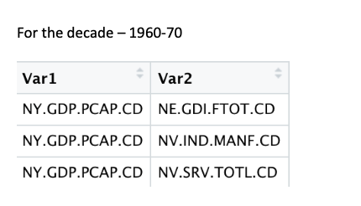
Decade analysis
We find the correlation analysis for each decade and observe a few reoccurring trends and also a few new unique trends which also faded away as the years passed . This is a preview of the data.

Slide 6
Data analysis :
The first step after finding the correlation factors is to find how our model behaves with respect to our current data for that we began with finding the approximate GDP by predicting GDP of the current year from 1960 to 2010.
GLM :
GLM does NOT assume a linear relationship between the dependent variable and the independent variables
We had made static and dynamic models of the regression. .
Static and Dynamic models :
For static we considered data from 1960 to 2010 and models were built and predicted the data from 2016 to 2018 .
In the dynamic , we consider the trends in the GDP up to the year preceding it .

Slide 7
Now to further improve the prediction we tried to find the best subset of factors that affected our prediction , we made models for both forward and backward analysis of the data which helps us eliminate a lot of invaluable information.
However , we also know that a lot of factors even though not directly contributing, they may be indirectly contributing to their results. But our pre-eliminary analysis showed a surprisingly good trend with an average error rate of 10%. Now this is a general overview of why subset selection is done.
Subset Selection:
To simplify our model (since we had 413 factors to remove the irrelevant or redundant factors)
To reduce overfitting

Slide 8
PCA:
To capture maximum variance , we did our analysis using Principal Component Analysis which transforms our attributes from our original dataset while retaining most the information in the dataset.
PCA had also helped us analyze the variance and performance of the data and enabled us to pick the top predictors which affected the GDP most for a particular country.
Since we have many factors PCA will consider the most important factors and retain as much information as possible.

Slide 9
Now to analyze the data to the highest extent , we used random forest with extreme gradient boosting to analyze the importance of each factor while eliminating the unnecessary data .
Here, each decision tree calculates the importance of each attribute at the split points and the performance measure is calculated by the GINI INDEX for each split point.
Random Forest :
Nonlinear multiple regression - Each leaf contains a distribution for the continuous output variable/s
Pruning – to prevent the overfitting of the random forest model

Slide 13


Slide 16
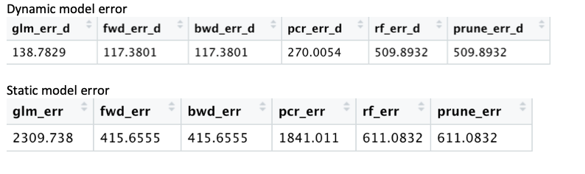
CONCLUSION OF RESULTS FOR VARIOUS MODELS
Observations:
We observed that the gaps in the GDP that were present in the static model led to highly unpredictable results which tells us that GDP is highly fluid and its factors change continuously and obsolete data is never a good factor to predict or to assume the financial stability of the country .

Slide 17
THE END
THANK YOU

